Slide 1
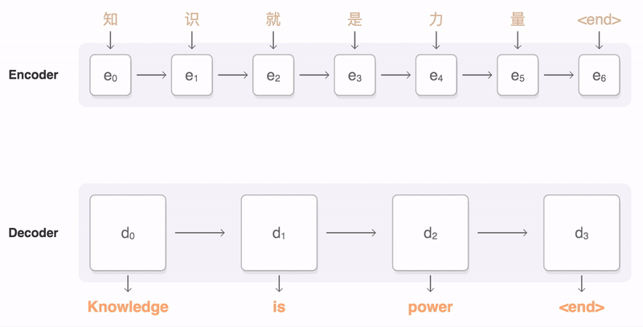
NEURAL MACHINE TRANSLATION BY JOINTLY LEARNING TO ALIGN AND TRANSLATE ‘ICLR 15’
Dzmitry Bahdanau
Jacobs University Bremen
KyungHyun Cho, Yoshua Bengio*
Universite de Montreal
Presenter: Happy Buzaaba
University of Tsukuba
D2 KDE Member
Supervisor: Prof Toshiyuki Amagasa
Date: 2019-04-22
Image source https://google.github.io/seq2seq/
Notes:
So today I decided to introduce this paper called ….
And the reason why i chose this paper is because it looks like the first paper to introduce attention mechanisms in machine translation. And also it gets more citations when people talk about attention mechanisms in Natural Language Processing.

Slide 2
Outline
Introduction
Previous work (Basic RNN encoder-decoder)
Learning to Align and Translate (Attention Mechanism)
Experiments and results
Discussion
Conclusion
Notes:
So a little bit outline of today’s session;
First we gonna talk briefly about the introduction and formal definition of the translation task in this case the paper translates from english to french.
I will also briefly talk about the baseline which is basically sequence to sequence for the sake of understanding the attention
And the third part is attention which is the main focus of this paper
I will also talk about BiRNN and how they are used here
At the end I raised some points for discussion

Slide 3
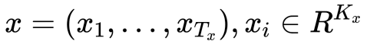
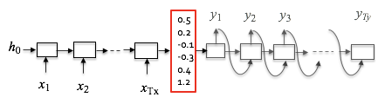
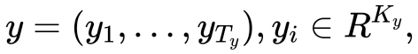
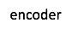
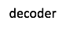
Overview Introduction: Machine Translation
Example
Jane visite l’Afrique en Septembre
Jane is visiting Africa in September.
Model inputs source sentence as 1-of-k coded word vectors
and outputs a translated sentence of 1-of-k coded word vectors
Tx and Ty: length of source and target languages respectively.
Kx and Ky: vocabulary sizes of source and target languages respectively,
Encoder: Finds the encoding of the input/source sentence
Decoder: Uses the encoding to generate target sentence translation
[Sutskever et al., 2014. Sequence to sequence learning with neural networks]
Notes:
Okay so let us start by a brief introduction of sequence to sequence.
And for me the easiest way to understand this was through examples.
So lets say you want to input a french sentence and you want to translate it to an english sentence Jane is visiting africa in september
So we represent the input sequence with x and the output sequence with y.
So we then train a neural network to input the sequence x and output the sequence y.
So first we build an RNN encoder network where we feed french sentence one word at a time
After ingesting the input sequence, the RNN outputs a vector that represents the input sentence.
After that we then build a decoder network which takes as input the encoder output
and then can be trained to output the translation one word at a time until when it outputs the end of sentence token.
And these ideas are mainly due to these two papers if anyone is interested to get more details.

Slide 4
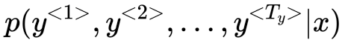
Overview Introduction
Given:
Jane visite l’Afrique en Septembre ,
Note: From the probabilistic perspective, Translation is equivalent to finding a target sentence y that maximizes the conditional probability of y given a source sentence x.
A common algorithm used in machine translation to find a value of y that maximizes conditional probability is Beam search.
Jane is visiting Africa in September.
Jane is going to be visiting Africa in September.
...
In September, Jane will visit Africa.
[Wiseman et. al., 2016. Sequence-to-Sequence Learning as Beam-Search Optimization]
Notes:
The model might tell you what is the probability of different corresponding english translations

Slide 5
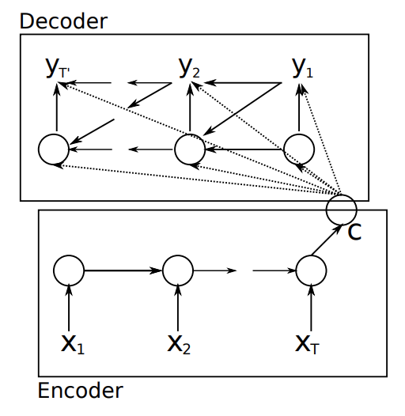
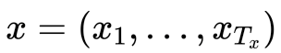
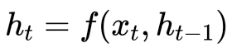
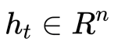
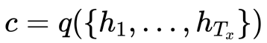
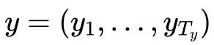
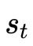
Previous work: Basic RNN Encoder-decoder definition
RNN-encoder: Map Input sentence x into a fixed-length context vector c.
RNN-decoder: Predict the output sentence y by maximizing the probability.
: encoder hidden state at time t
: decoder hidden state at time t
[Cho et. al., 2014.Learning phrase representations using RNN encoder-decoder for statistical machine translation]
Notes:
So as we translate we have three inputs for the decoding step
We compute every hidden state for decoder from:
Previous hidden state (standard)
Last hidden vector of the encoder C
Previous predicted output word yt-1

Slide 6
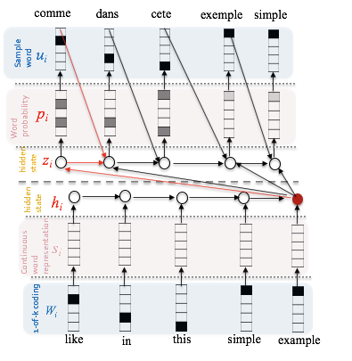
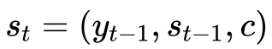
Basic RNN Encoder-decoder
Compute every hidden state in decoder from
- Previous hidden state (standard RNN)
- Last hidden vector of the encoder C
- Previous predicted output word
Decoder
C
Encoder
Decoder hidden state at time t
Notes:
Another way of looking at the encoder- decoder, this picture is the same as the previous one
So as we translate we have three different inputs for each hidden state during the decoding step.

Slide 7
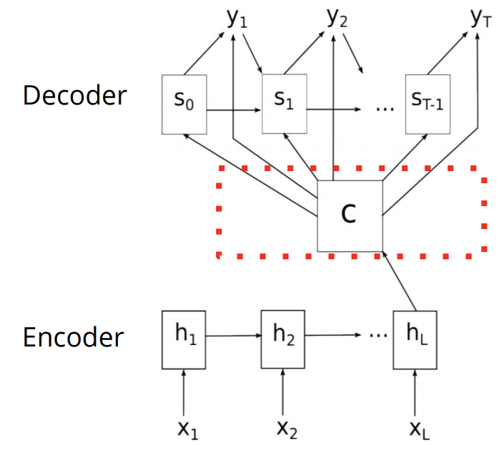
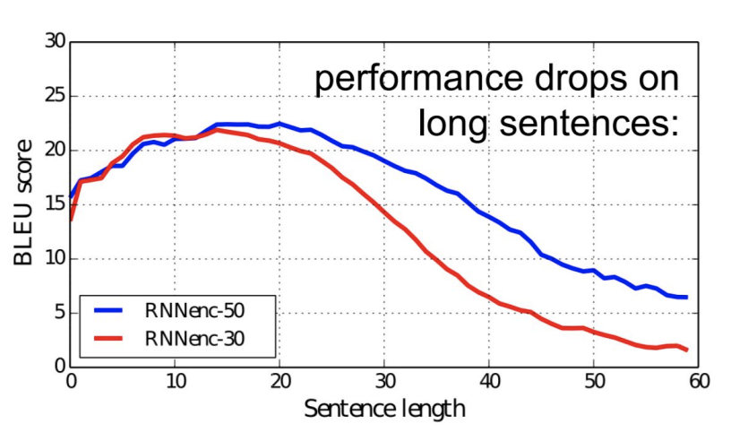
RNN Encoder-decoder: Short falls
Even with LSTM/GRU
Has to remember the whole sentence
Fixed size representation can be a bottleneck
Humans do it differently
Need to attend to each individual word
Fixed size representation
Cho et. al., 2014. On the Properties of Neural Machine Translation: Encoder-Decoder Approaches
Notes:
What are some of the challenges or the short falls with the RNN encoder decoder
So the RNN itself has got attendance to put more emphasis on things it has seen recently even for longer sentence so what it has seen earlier is forgotten.
So this is the problem as you can see, as the length of sentence increases, the performance drops.
Another potential issue is that the neural network has to compress all the necessary information of a source sentence into a fixed-length vector
Which may make it difficult to cope with longer sentences. Especially those that are longer than the sentences in the training corpus.

Slide 8
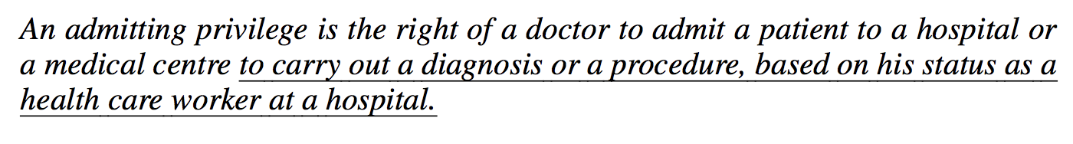
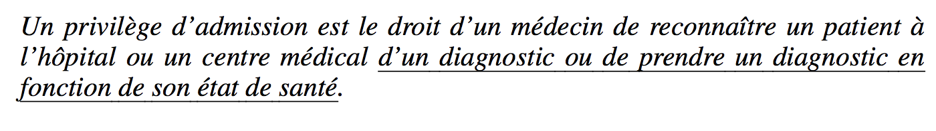
Basic RNN Encoder-decoder: shortfall example
Deviation in the end of long sentences
“based on his state of health???”
Notes:
In this case the encoder-decoder correctly translated up to a medical center.
From there on (the underlined it deviated from the original meaning of the source sentence).

Slide 9
Learning to Align and Translate: Attention Mechanism
Neural machine translation models often encode source sentence into a fixed-length vector from which a decoder generates translation. However, they do suffer on long sentences.
Rather than building a single context vector out of the encoder’s last hidden state, the secret sauce invented by attention is to create shortcuts between the context vector and the entire source input. The weights of these shortcut connections are customizable for each output element.

Slide 10
Learning to Align and Translate
Key Idea
Translate sentence part by part.
The agreement on European Economic Area was signed in 1992
L'accord sur
L'accord sur l'Espace économique européen a été signé en ???
Have such hints computed by the network itself!
Notes:
So assuming you have a long sentence a human translator will probably translate the first few words and then the next few words and so on.
So the idea is for the network to be able to have a similar approach as that of a human in that case you avoid memorising the entire sentence.

Slide 11
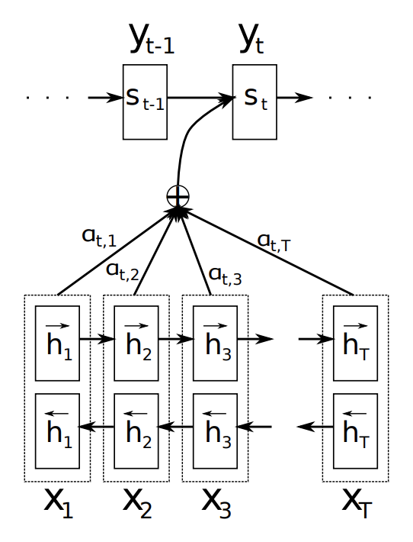
Main Contribution
Propose a novel architecture for NMT
The encoder: a bi-derectional RNN
The hidden state should encode information from both previous and following words.
The decoder: proposed an extension (attention) model
attention mechanism: weighted sum of the input hidden states
[Bahdanau et. al., 2015. Neural machine translation by jointly learning to align and translate]
Notes:
And so the main contribution of this paper is that

Slide 12
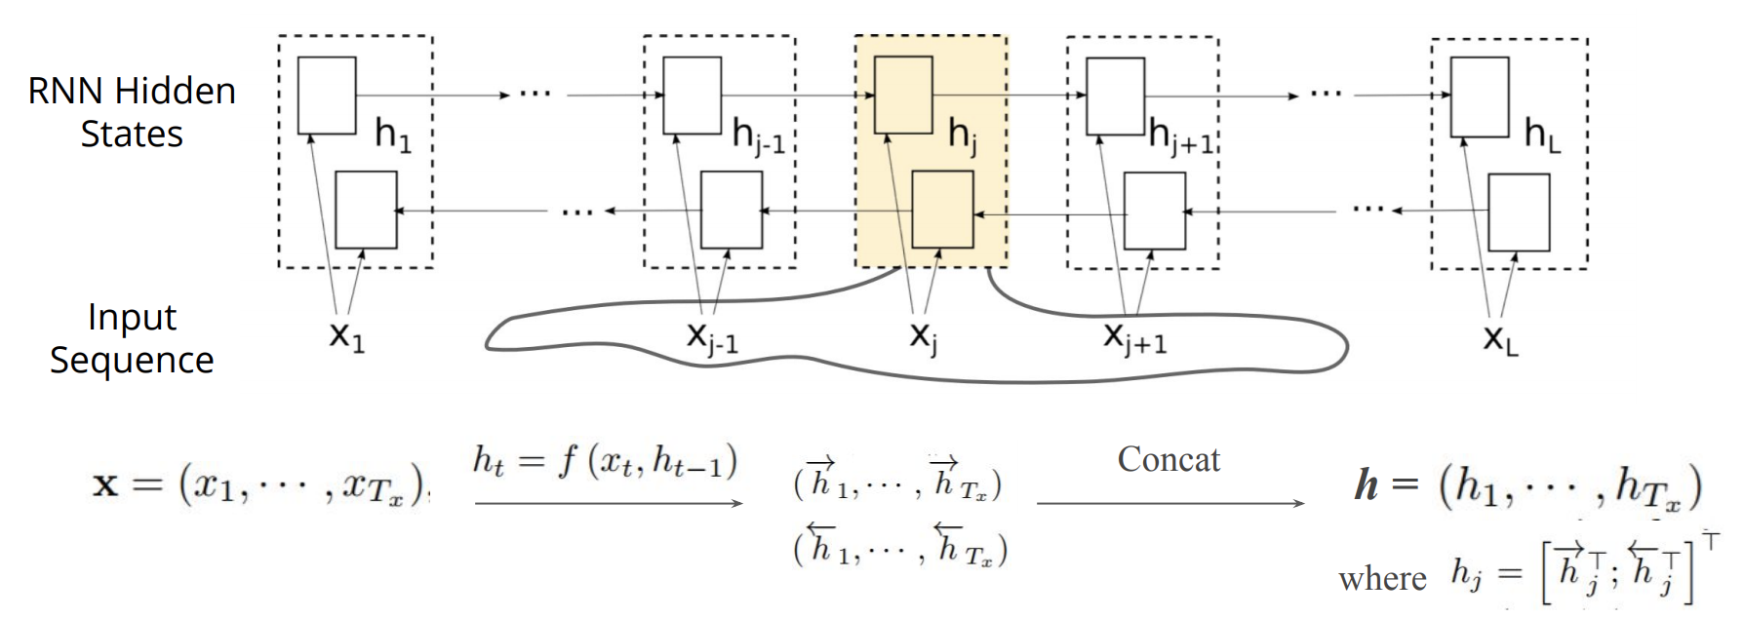
New encoder
Bidirectional RNN
The motivation is to include both the preceding and following words in the annotation of one word
Image source: https://iclr.cc/archive/www/lib/exe/fetch.php%3Fmedia=iclr2015:bahdanau-iclr2015.pdf
Notes:
BRNN: hj contains xj with its context (..., xj-1, ,xj+1, …). (h1, ...., hL) is the new variable length representation instead of a fixed length.
So the hidden state at every time step is a concatenation og both hidden states

Slide 13
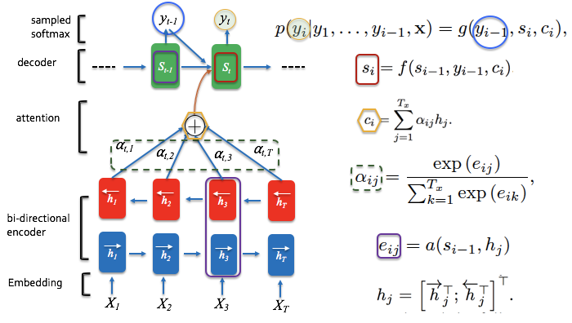
Learning to Align and Translate

Slide 14
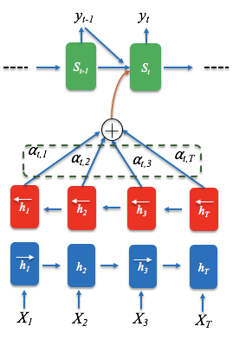
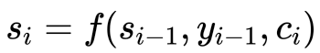
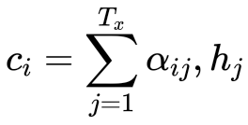
New architecture
The decoder hidden state for the output ward at time step t is
The context vector is the sum of the hidden states of the input sequence, weighted by alignment scores
Sampled softmax
Decoder
Context vector
Attention
BiRNN- Encoder
Embedding

Slide 15
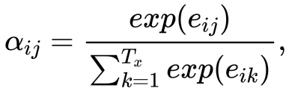
New architecture
3. The weight for each annotation/hidden state is computed as a softmax of some predefined alignment score
4. Where the alignment assigns a score to the input at position j and output at position i based on how well they match
NB: The weights defines how much of each source hidden state should be considered for each output
Sampled softmax
Decoder
Context vector
Attention
BiRNN- Encoder
Embedding

Slide 16
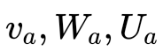
New architecture
4. Where the alignment assigns a score to the input at position j and output at position i based on how well they match
Assuming tanh is used as non-linear activation function, the score function is in the following form:
are weight matrices to be learned in the alignment model
Sampled softmax
Decoder
Context vector
Attention
BiRNN- Encoder
Embedding

Slide 17
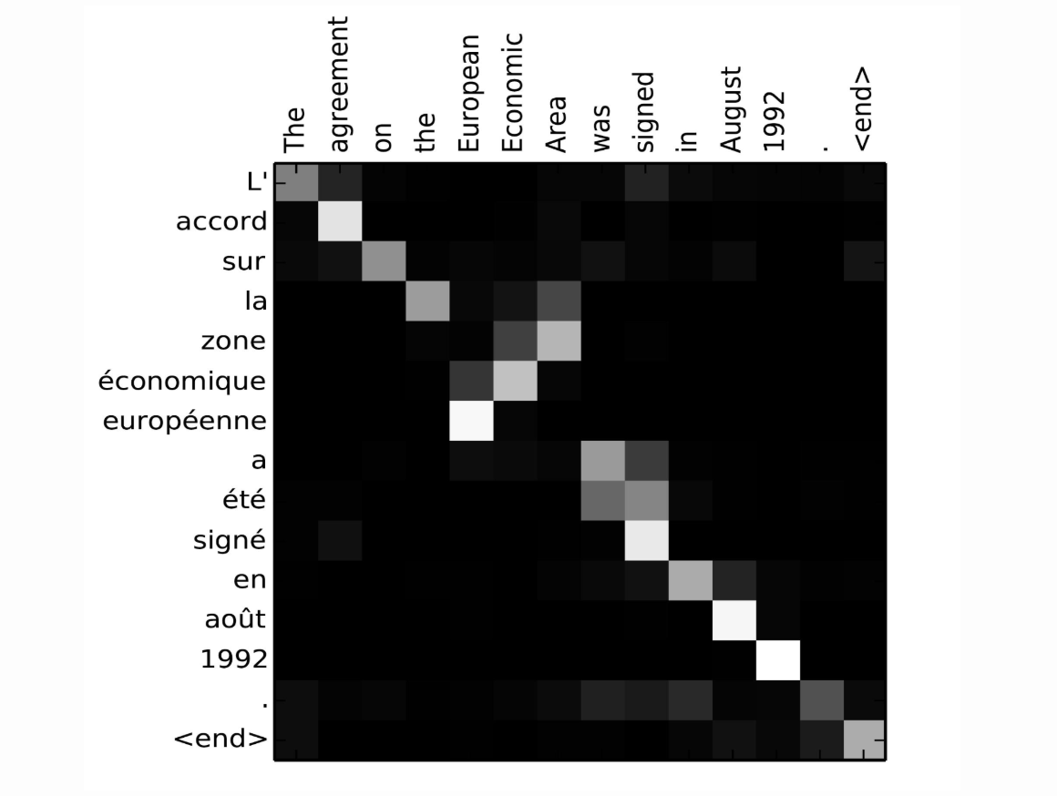
Alignment matrix: Explicitly shows the correlation between source and target words
Alignment matrix of “L’accord sur l’Espace économique européen a été signé en août 1992” (French) and its English translation “The agreement on the European Economic Area was signed in August 1992”
Each row of a matrix in indicates the weights associated with the annotations.
From this we see which positions in the source sentence were considered more important when generating the target word.

Slide 18
Intuitions
[Our model] does not attempt to encode the whole input sentence into a fixed-length vector. Instead, it encodes the input sentence into a sequence of vectors and chooses a subset of these vectors adaptively while decoding the translation.
Each time the proposed model generates a word in a translation, it (soft-) searches for a set of positions in a source sentence where the most relevant information is concentrated.
With this new approach the information can be spread throughout the sequence of annotations, which can be selectively retrieved by the decoder accordingly.

Slide 19
Experiment: English to French
Model
RNN search, 1000 units
Baseline:
RNN encoder-decoder, 1000 units
Moses, a SMT system (Koehn et al. 2007)
Data: http://www.statmt.org/wmt14/translation-task.html ACL WMT’14
English to French translation, 348 million words
30,000 most frequent words + UNK token to train the model
Training:
SGDw/ Adadelter
Mini-batch: 80 sentences
Train the model for approximately 5 days (Beam search+Blue)
1000 units (size of hidden layer)
Word Embedding dimensionality 650
Beam width 12
Notes:
So for beem search, because at the end or at the output y, we generate an embedding then we look at the vocabulary to see which one is more probable and we keep that. And use that to compute the probability of the next word.

Slide 20
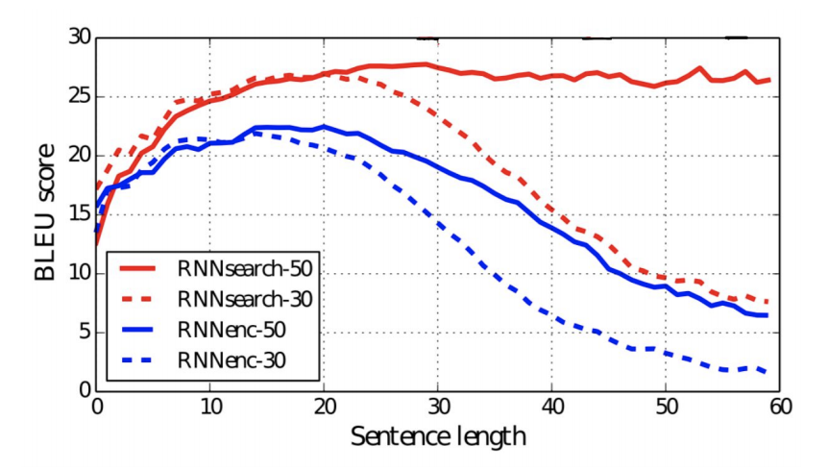
Quantitative results
No performance drop on long sentence
BLEU scores of the generated translations on the test set with respect to the lengths of the sentences. The results are on the full test set which includes sentences having unknown words to the models
Notes:
Moses is the God of the baseline in Machine translation
* means that the model was trained for a very long time until the performance on the development set stoped.

Slide 21
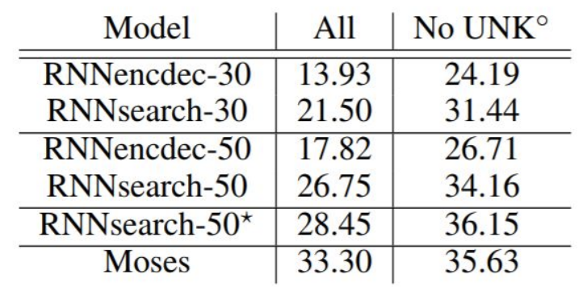
Quantitative results
RNNsearch much better than RNN encoder-decoder
BLEU scores of the trained models computed on the test set. The second and third columns show respectively the scores on all the sentences and, on the sentences without any unknown word in themselves and in the reference translations.
RNNsearch-50*, was trained much longer until the performance on the development set stopped improving.
(◦) We disallowed the models to generate [UNK] tokens when only the sentences having no unknown words were evaluated (last column)
SMT
Without unknown words, comparable with SMT
Notes:
Moses is the God of the baseline in Machine translation
* means that the model was trained for a very long time until the performance on the development set stoped.

Slide 22
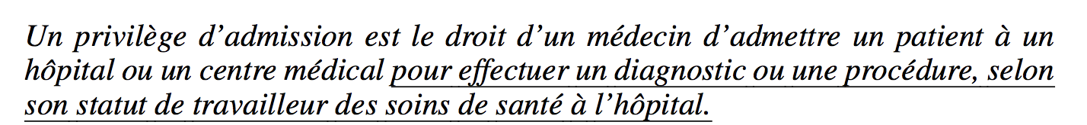
Qualitative Results: Translation
New model RNNsearch-50
Correct!
Encoder-decoder RNNencdec-50
“based on his state of health???”

Slide 23
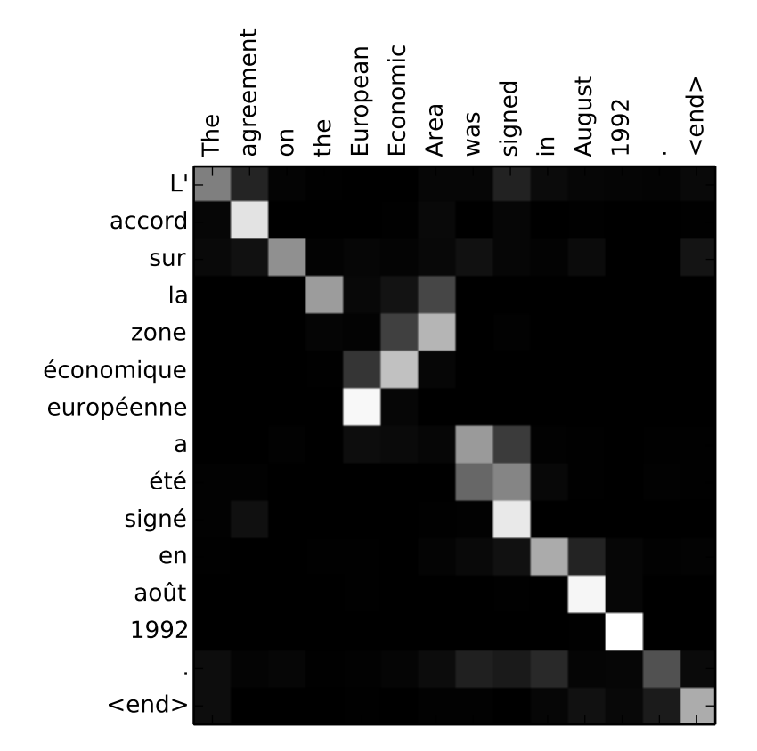
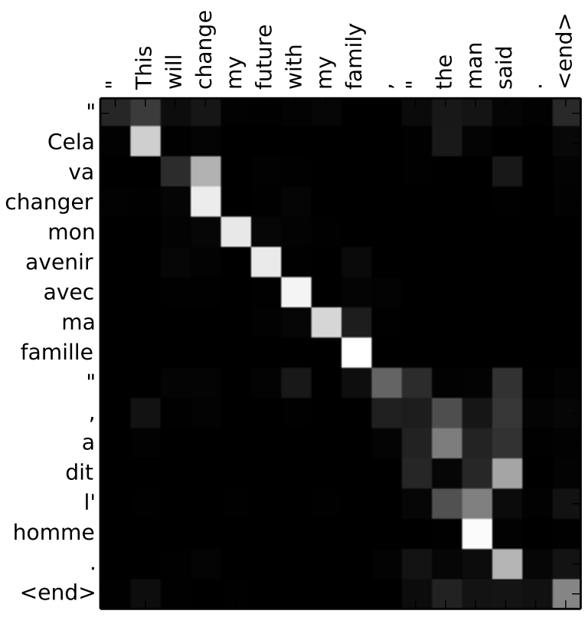
Discussion: Qualitative Analysis Alignment
Figure shows sample alignments found by RNNsearch-50. The x-axis and y-axis of each plot correspond to the words in the source sentence (English) and the generated translation (French), respectively. Each pixel shows the weight αij of the annotation of the j-th source word for the i-th target word in grayscale (0: black, 1: white).

Slide 24
Discussion:Qualitative Analysis Alignment
Alignment of words between English and French is largely monotonic. We see strong weights along the diagonal of matrix.
However, we also observe a number of non-monotonic alignments. Adjectives and nouns are typically ordered differently between French and English.
Example:
The model correctly translates a phrase [European Economic Area] into [zone economique européen].
The model was also able to correctly align [zone] with [Area], jumping over the two words ([European] and [Economic]), and then looked one word back at a time to complete the whole phrase [zone economique européen]

Slide 25
Discussion: Qualitative Analysis Alignment
The strength of the soft-alignment, opposed to a hard-alignment, is evident. For instance, Consider the source phrase [the man] which was translated into [l’ homme].
Any hard alignment will map [the] to [l’] and [man] to [homme]. This is not helpful for translation, as one must consider the word following [the] to determine whether it should be translated into [le], [la], [les] or [l’].
Our soft-alignment solves this issue naturally by letting the model look at both [the] and [man], and in this example, we see that the model was able to correctly translate [the] into [l’].

Slide 26
Conclusion
We extended the basic encoder–decoder by letting a model (soft-)search for a set of input words, or their annotations computed by an encoder, when generating each target word. This frees the model from having to encode a whole source sentence into a fixed-length vector, and also lets the model focus only on information relevant to the generation of the next target word.
The experiment revealed that the proposed RNNsearch outperforms the conventional encoder–decoder model (RNNencdec) significantly, regardless of the sentence length. From the qualitative analysis we were able to conclude that the model can correctly align each target word with the relevant words, or their annotations, in the source sentence as it generated a correct translation.
The proposed approach achieved a translation performance comparable to the existing phrase-based statistical machine translation. It is a striking result, considering that the proposed architecture, has only been proposed recently. We believe the architecture proposed here is a promising step toward better machine translation and a better understanding of natural languages in general.

Slide 27
Appendix: Self Study Greedy search
Greedy search will pick the most likely token and move on.
For any input x;
Given x, find the word y(0) with the highest probability using RNN
Given y(0) and x, find word y(1) with the highest probability using RNN
….
Stop when see <end>
It’s too greedy

Slide 28
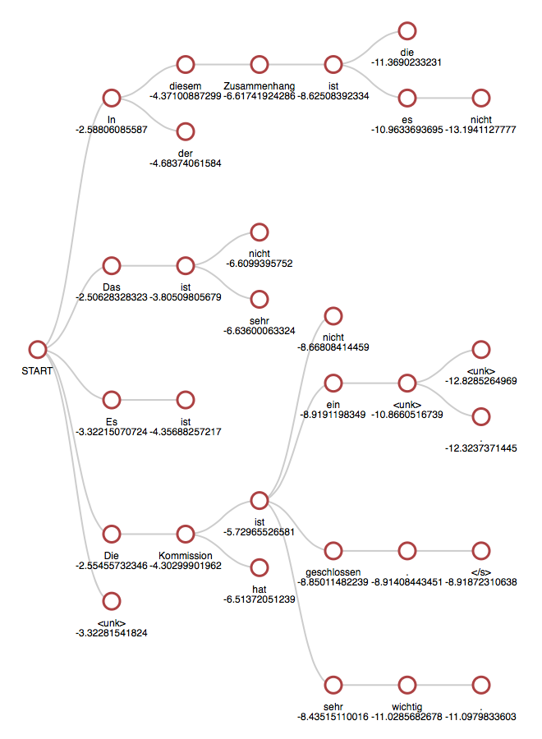
Self Study Greedy search
Beam Search considers multiple alternatives at each time step, eg B = 5 (beam width)
For any input x,
Given x, find k candidates for y(0) with highest probability using RNN
Given x, for each candidate y(0) find find k candidates for word y(1) with the highest probability using RNN
….
Stop when see <end>
Output = Beam with highest probability

Slide 29
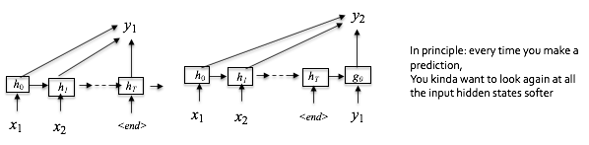
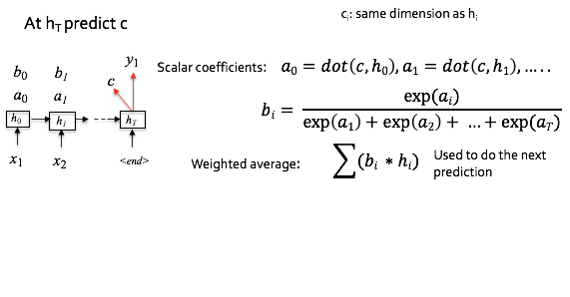
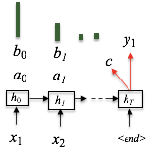
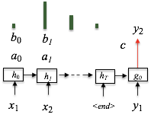
Appendix: Self Study attention

